Slide 1
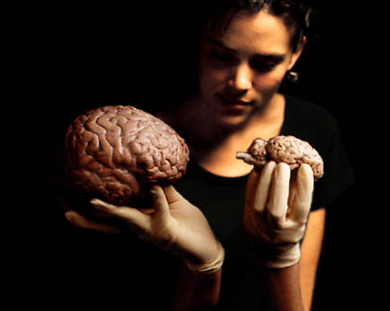
Sheep Brain Dissection
Keep a record of all the structures on the following slides.

Slide 2
Dura Mater

Slide 4
Pons
Medulla
Pituitary Gland
Cerebellum

Slide 6
Sheep Brain Lab Report
Draw brain(s) and label all structures listed on this PowerPoint.
Pick three structures that differ from those in a human brain and explain why those differences may exist.
Due Thursday April 18.

