Slide 1
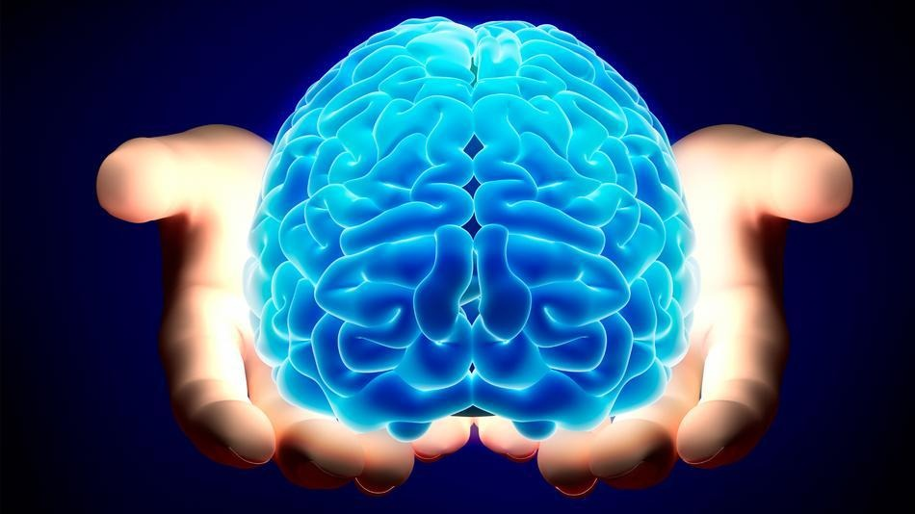
The NERVOUS SYSTEM

Slide 2
Fascinating Facts about our Nervous System
There are more nerves in a single human brain than there are stars in our galaxy.
If all of the nerve cells in a human brain were lined up end to end, it would be about 600 miles long.
A developing fetus makes about 250,000 new brain nerve cells per day.
A newborn’s brain grows three times in size in the first year of life.
Adult female brain: ~1275g

Slide 3
Fascinating Facts about our Nervous System
Adult male brain: ~1375g
We all lose about 1g / year as we age.
While all of the cells in a brain are used, only ~4% are being used at any given point.
Message transmission is ~180mph.
What did the brain do when it saw a friend across the street?

Slide 4
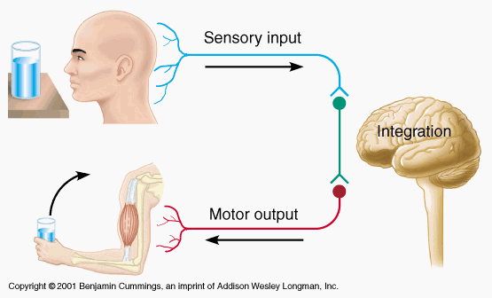
I. Overview of the Nervous System
Three Major Functions
1. Gathering Sensory Input
*Monitors changes around
you (called “stimuli”).
2. Integration of Input
*processing and interpreting of sensory input.
*what should be done about the stimuli?
3. Generation of Motor Output
*telling the body how to respond to the stimuli

Slide 5
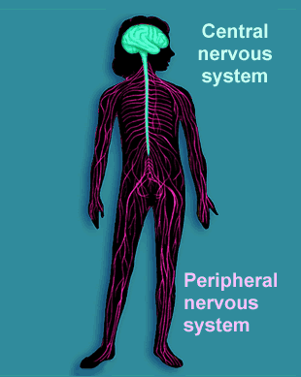
I. Overview of the Nervous System (continued)
B. Two Major Divisions
1. Central Nervous
System (CNS)
*Brain & Spinal Cord ONLY
2. Peripheral Nervous
System (PNS)
*All nerves OUTSIDE of CNS

Slide 6
I. Overview of the Nervous System (continued)
2. Peripheral Nervous System (continued)
a. Sensory (Afferent) Division
*carries messages to the CNS
b. Motor (Efferent) Division
*carries messages from the CNS
*two divisions of motor nerves:
1) Voluntary (Somatic) Nerves
2) Involuntary (Autonomic) Nerves

Slide 7
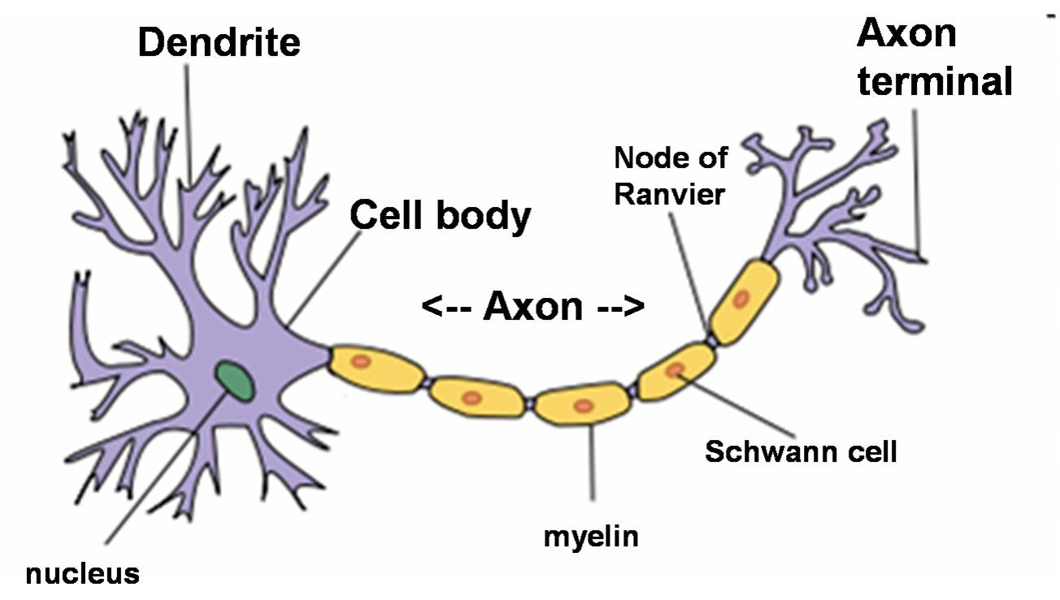
I. Overview of the Nervous System (continued)
C. Structure of a Nerve Cell (Neuron)
1. Cell Body – main part of cell with nucleus
2. Dendrites – receive incoming messages
3. Axon – large filament that carries message (≤4’ long)

Slide 8
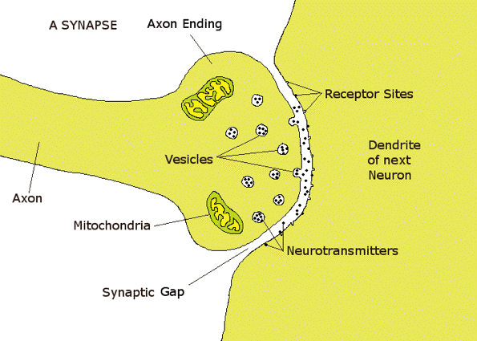
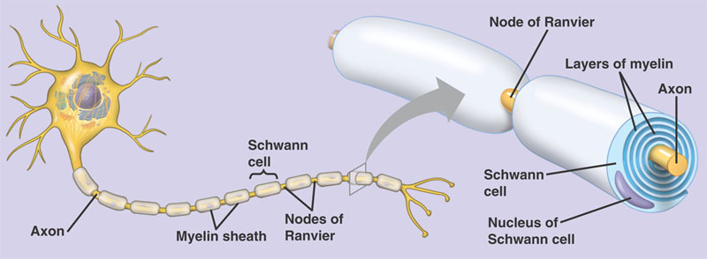
I. Overview of the Nervous System (continued)
C. Structure of a Nerve Cell (Neuron)
4. Myelin – whitish, waxy, fatty material
5. Schwann cell – layers of myelin that
insulate axon
6. Synaptic cleft – small space between neurons

Slide 9
II. How Nerves Carry Messages
A. Two Essential Functions of a Nerve:
1. Irritability
*the ability to convert a stimulus into an
electrical impulse.
*all-or-nothing response.
*threshold = the amount of stimulus that it
takes to cause an impulse.
2. Conductivity
*the ability to send and carry the impulse.

Slide 10
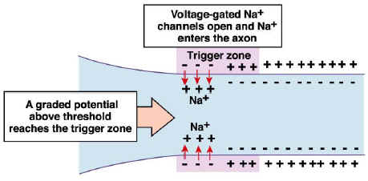
II. How Nerves Carry Messages (continued)
B. How a Stimulus is Converted into an Impulse
1. Unstimulated nerve has pos. ions on outside
and neg. ions inside of axon membrane.
2. Nerve is UNPOLARIZED.

Slide 11
II. How Nerves Carry Messages (continued)
B. How a Stimulus is Converted into an Impulse
3. Stimulus threshold is reached.
4. Nerve now becomes IRRITATED.
5. Pos. and neg ions switch places, which disrupts
the axon’s balance and makes an electrical
impulse. Nerve is now POLARIZED.

Slide 12
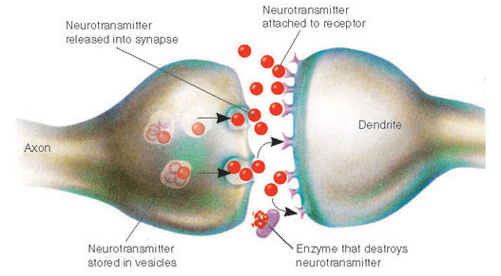
II. How Nerves Carry Messages (continued)
B. How a Stimulus is Converted into an Impulse
6. Electrical impulse cannot jump the gap
between the nerves (synaptic cleft).
7. Impulse causes a chemical (neurotransmitter)
to flood across gap.

Slide 13
II. How Nerves Carry Messages (continued)
B. How a Stimulus is Converted into an Impulse
8. Neurotransmitter triggers electrical impulse
to travel along next axon.
9. Electrical impulse + Chemical signal =
ELECTROCHEMICAL SIGNAL (get it?)

Slide 14
III. Reflexes
A. Rapid, predictable, involuntary responses
to stimuli.
1. examples: knee-jerk, gag, pupil,
blinking, withdrawal, infant grasp
2. Try some of these:
Image Reaction Red Light/Green Light
Color Reaction Letter

Slide 15
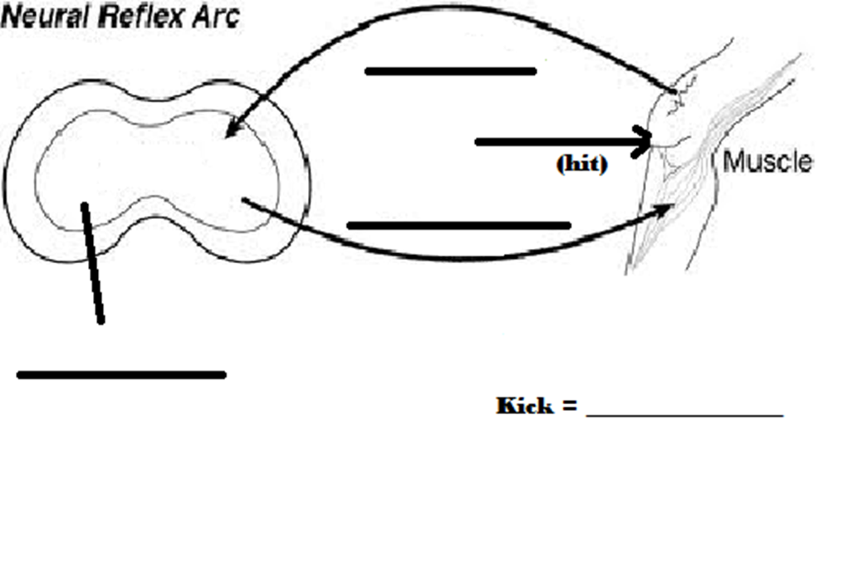
III. Reflexes (continued)
B. How a Reflex Arc Works:
1. Involves just a few neurons
2. Signal travel only to the spinal cord, not all
the way to the brain – very fast.
3. The spinal cord “tells” the body what to do
before the brain even gets the message.

