Slide 1
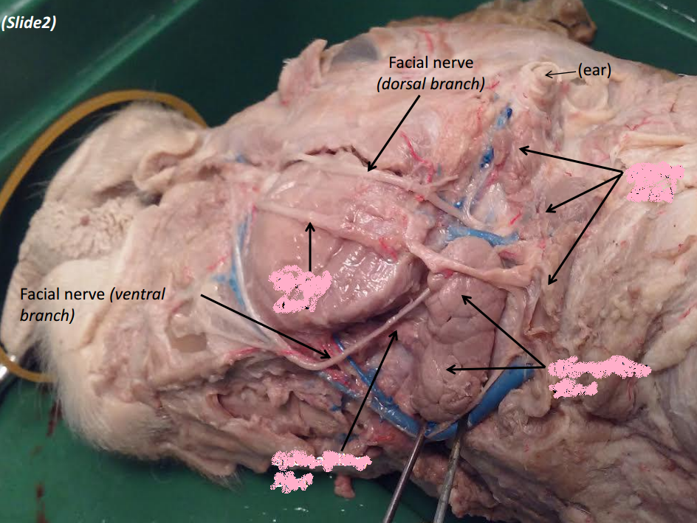

Slide 2
Parotid Salivary Gland

Slide 4
Parotid Salivary Duct

Slide 6
Submaxillary Salivary Gland

Slide 7
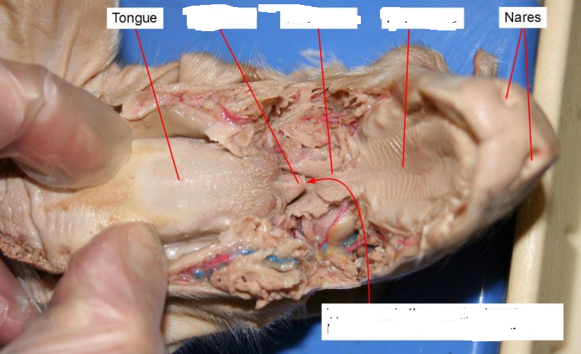

Slide 8
Epiglottis

Slide 10
Soft Palate

Slide 12
Hard Palate

Slide 14
Glottis

Slide 15
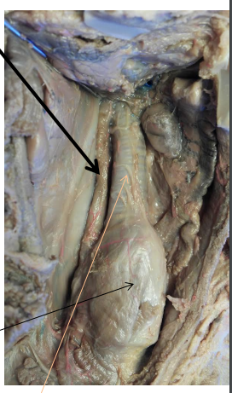

Slide 16
Esophagus

Slide 17
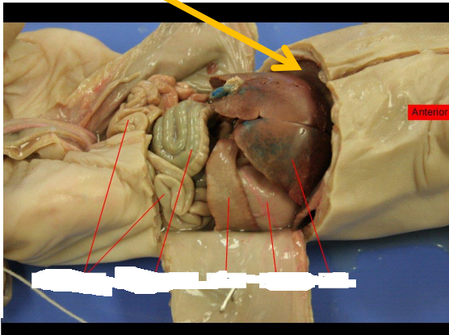

Slide 18
Small Intestine

Slide 20
Large Intestine

Slide 22
Spleen

Slide 24
Stomach

Slide 26
Liver

Slide 27
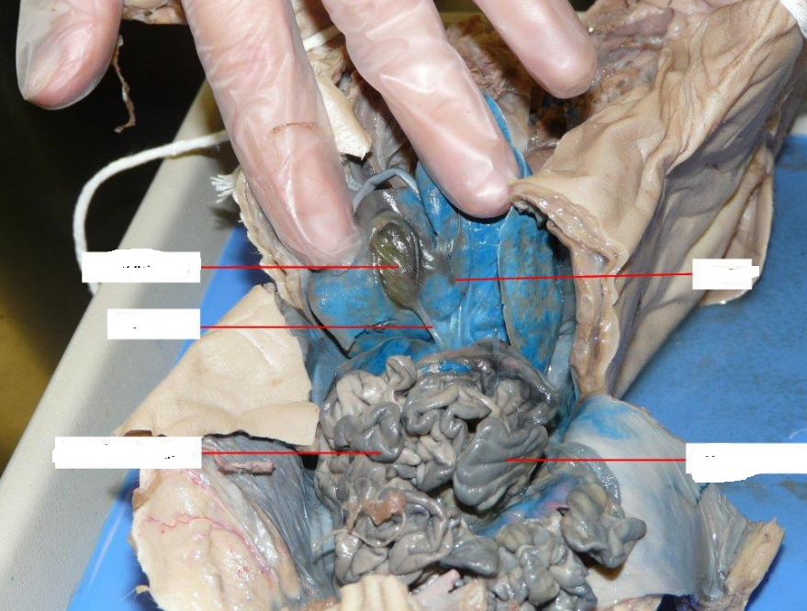

Slide 28
Gall Bladder

Slide 30
Common Bile Duct

Slide 32
Small Intestine (Jejunum)

Slide 34
Liver

Slide 36
Large Intestine

Slide 37
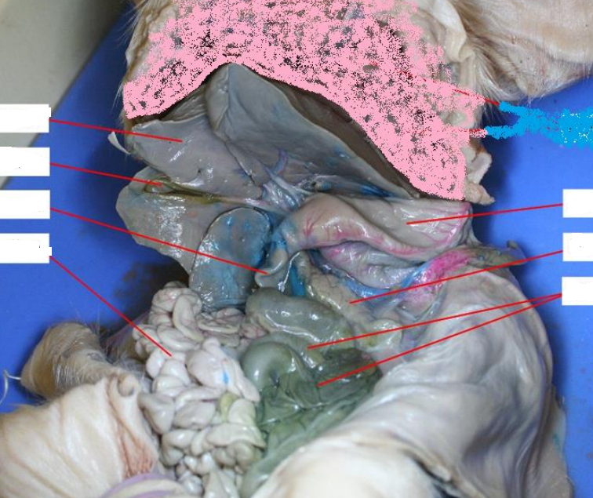

Slide 38
Pancreas

Slide 40
Large Intestine

Slide 41
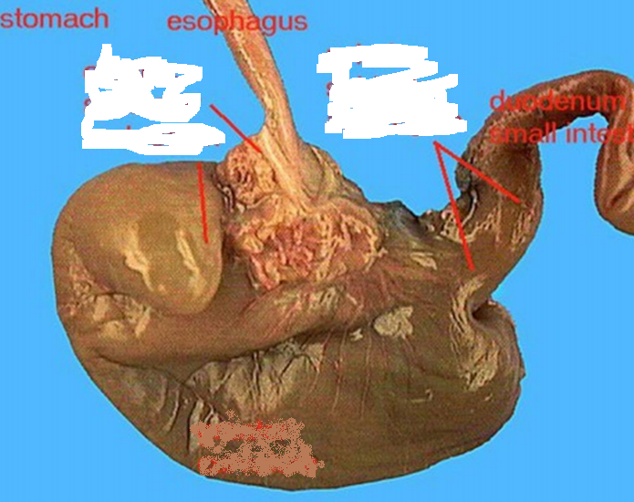

Slide 42
Cardioesophageal Sphincter

Slide 44
Pyloric Sphincter

Slide 46
Lesser Curvature

Slide 48
Greater Curvature

Slide 50
Fundus

Slide 51
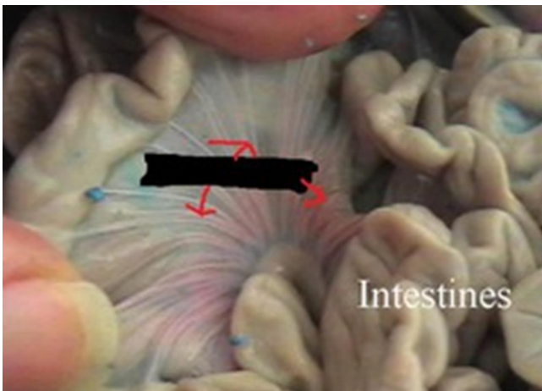

Slide 52
Mesentery

Slide 53
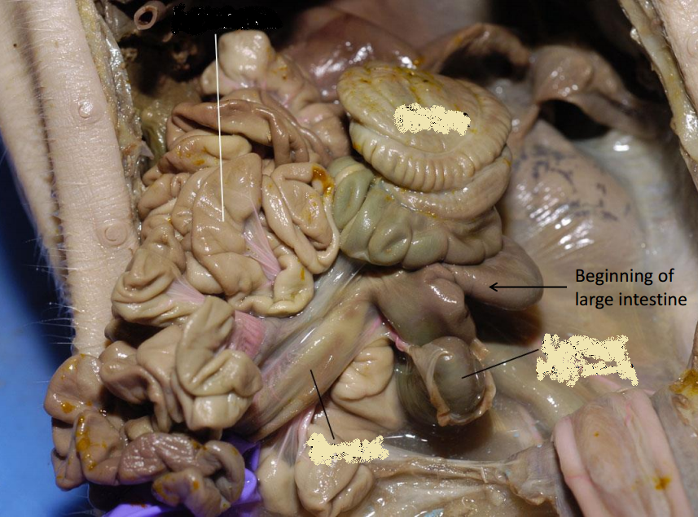

Slide 54
Caecum

Slide 56
Ileum

Slide 58
Large Intestine

Slide 60
Jejunum

Slide 61
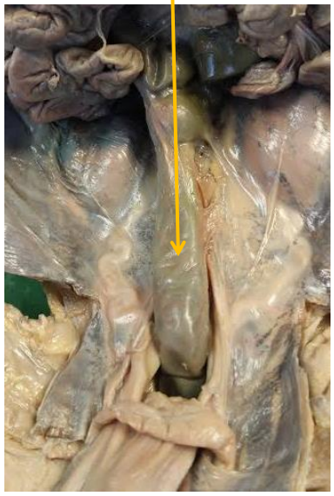

Slide 62
Rectum

Slide 63
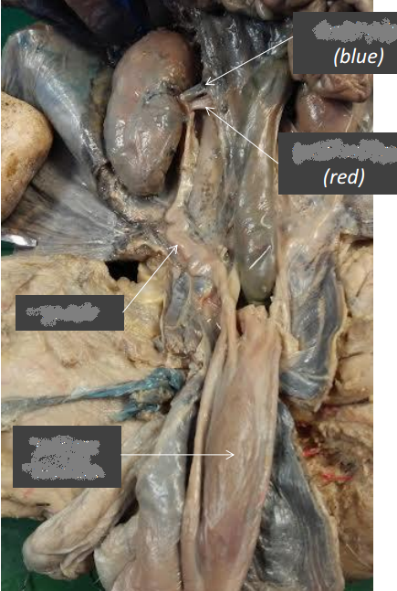

Slide 64
Renal Artery & Vein

Slide 66
Kidney

Slide 68
Ureter

Slide 70
Urinary Bladder

Slide 71
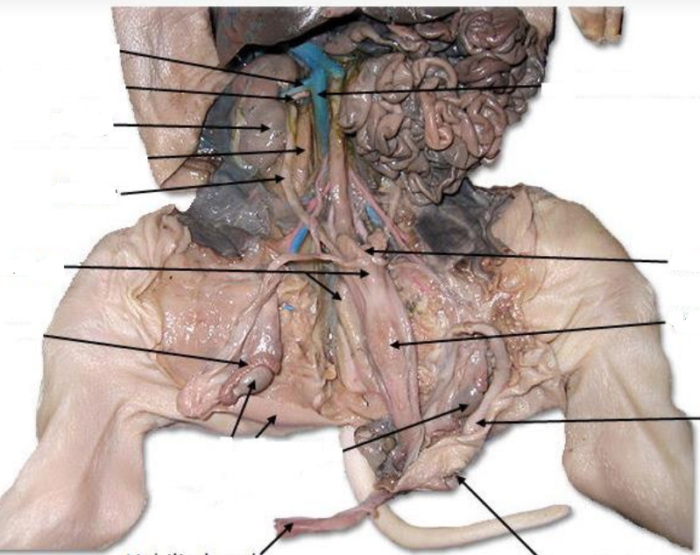

Slide 72
Colon

Slide 74
Ureter

Slide 76
Urinary Bladder

Slide 77
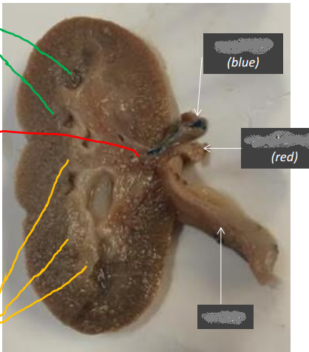

Slide 78
Renal Artery & Vein

Slide 80
Medullary Pyramids

Slide 82
Calyx (Calyces plural)

Slide 84
Renal Pelvis

Slide 86
Ureter

Slide 88
Renal Cortex

