Slide 1
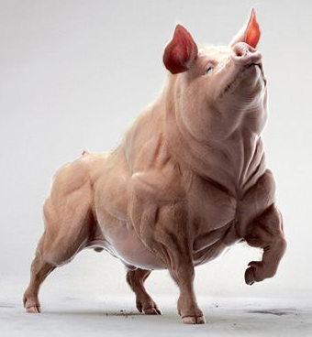
Piggy Muscular System
First Steps:
Part I – Skinning the Piggy
Part II – Final Skinning &
Muscle Identification

Slide 2
Muscles to Find, Photograph & KNOW!!!
Sternocleidomastoid
Pectoralis Major & Minor (these are distinctly different in the pig)
Latissimus Dorsi
External Oblique
Rectus Abdominus
Masseter
Biceps Femoris
Triceps
Intercostals
Gastrocnemius
Achilles Tendon
Biceps Brachii (you’ll have to cut away the pectoralis major to see this)
Gluteal Muscles (we’ll lump the G. Maximus & G. Minimus together)

Slide 3
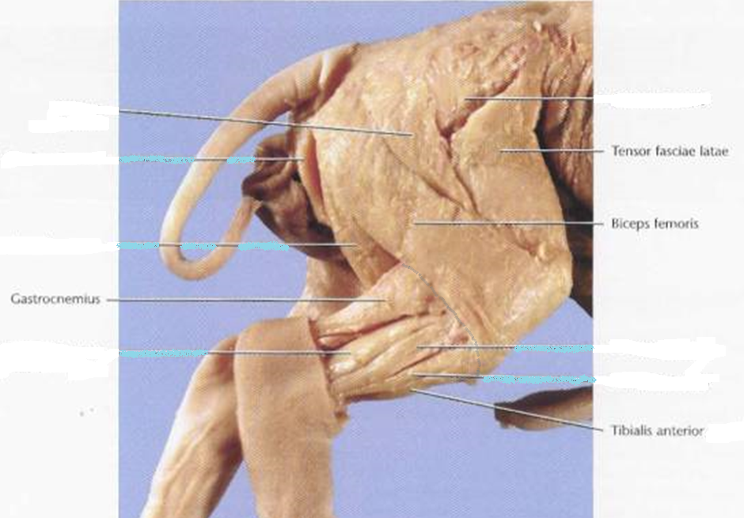
Example of a Well-Dissected Rear-End
Gluteal Muscles
Tensor Fascae
Biceps Femoris
Gastrocnemius
Achilles' Tendon
Tibialis Anterior
(Skin to here)

Slide 4
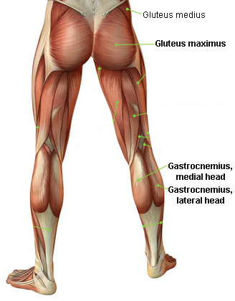
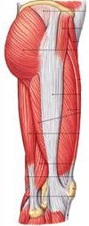
Human Analogs to Piggy Hind Leg Muscles
Posterior Aspect
Lateral Aspect
Biceps Femoris
(part of the “hamstrings” group)
Tensor Fasciae

Slide 5
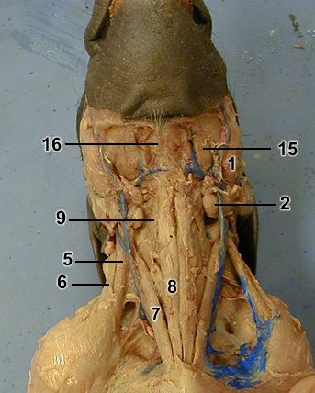
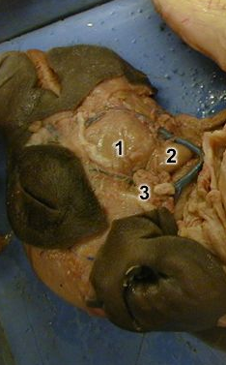
Head & Neck Muscles
Masseter
Sternocleidomastoid

Slide 6
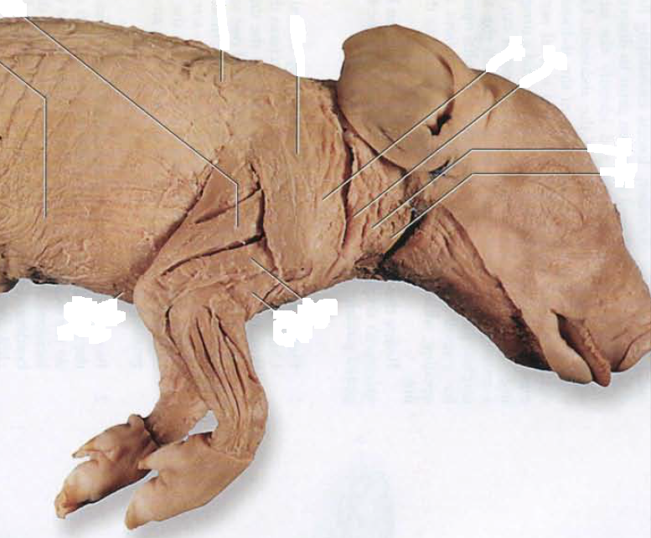
Shoulder Muscles
Trapezius
Deltoid
Triceps

Slide 7
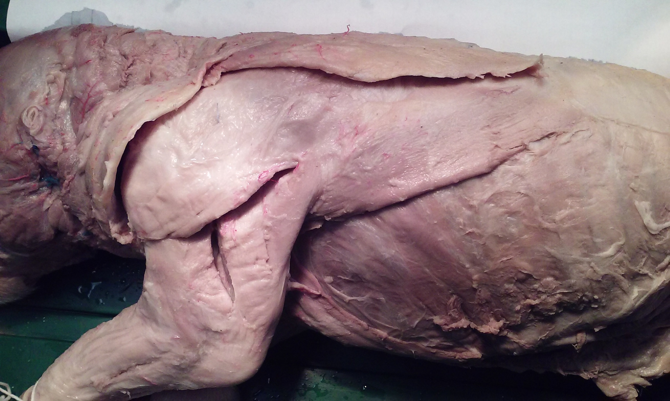
Shoulder Muscles
Trapezius (looks like it wraps around front of deltoid)
Latissimus Dorsi
Deltoid
Triceps

Slide 8
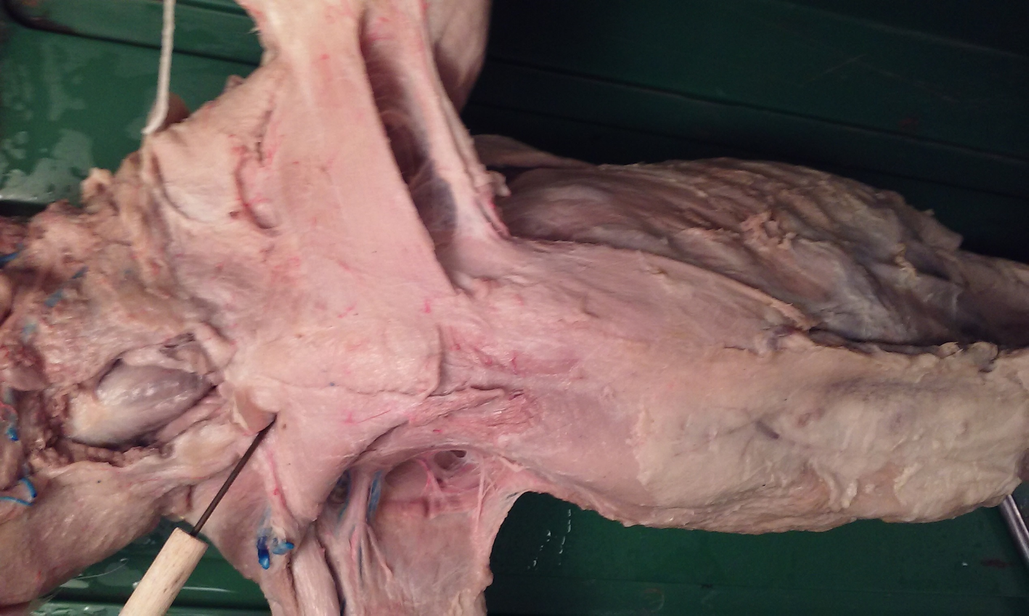
Chest
Biceps
Pectoralis Major
Pectoralis Minor
(head)

Slide 9
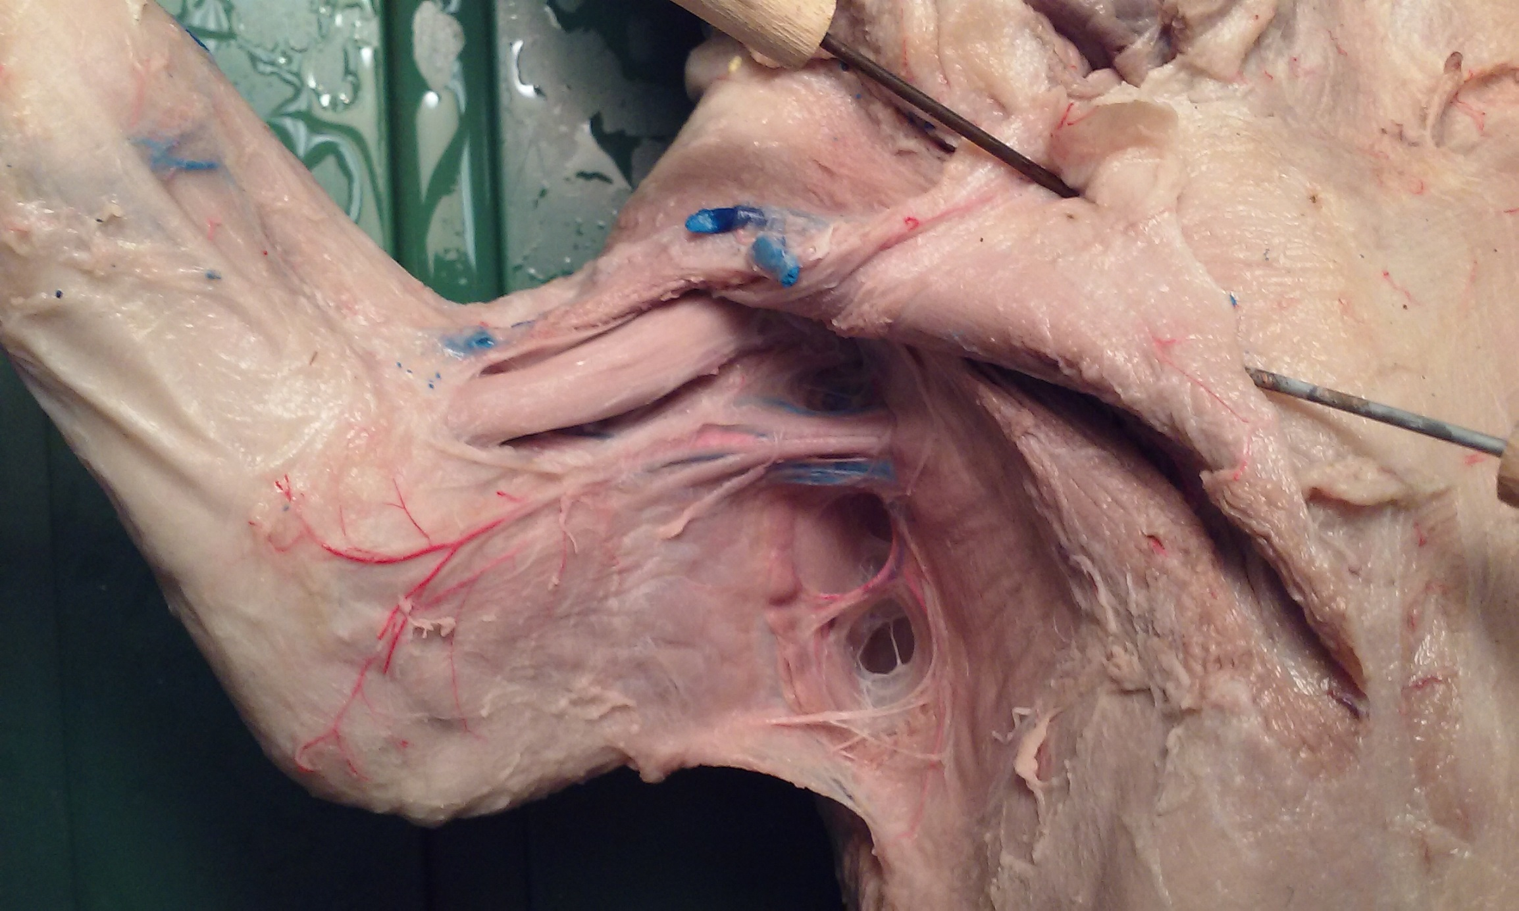
Forelimb
Biceps
(the Pectoralis Major needs to be reflected back to see this muscle)

Slide 10
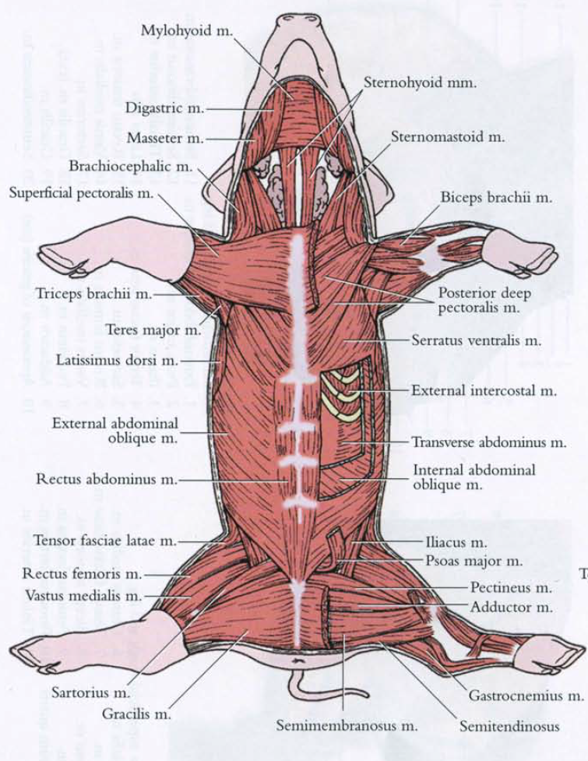
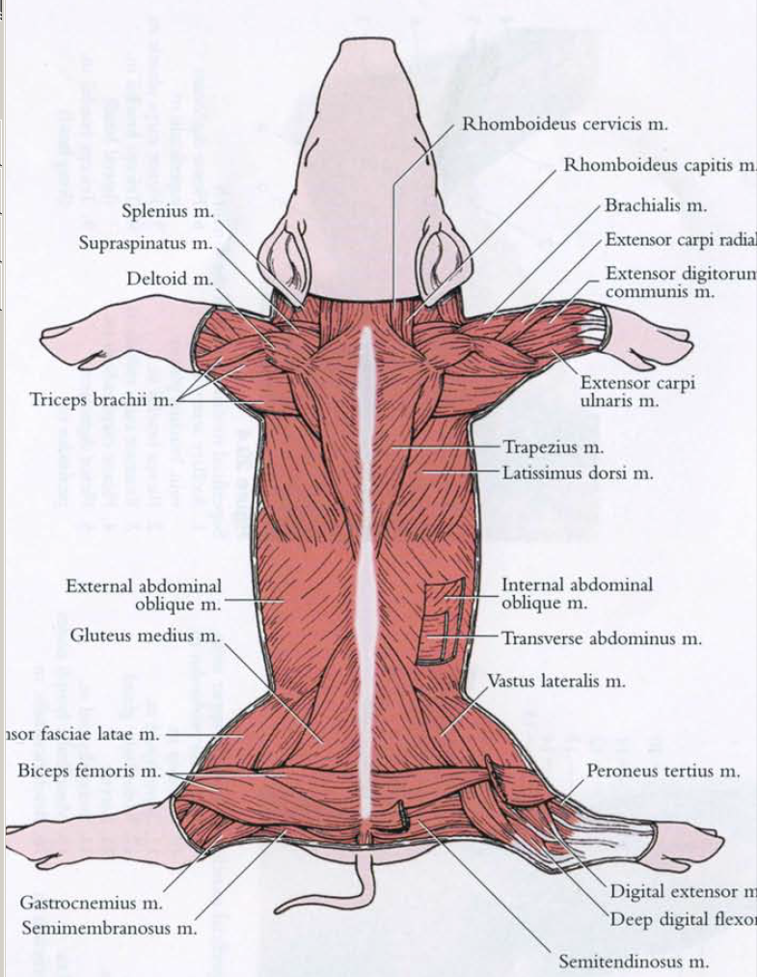

Slide 11
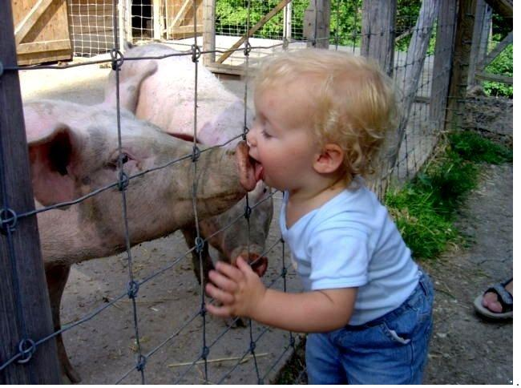
Get yer piggies and get started!!!

