Slide 1
Welcome to the RAT DISSECTION!!! (yeah!!!!!!!!)
In this lab, we will examine the major structures and organ systems of a typical mammal, including:
External Features
Muscular System
Skeletal System
Digestive System
Excretory / Reproductive Systems
Respiratory System
Cardiovascular System

Slide 2
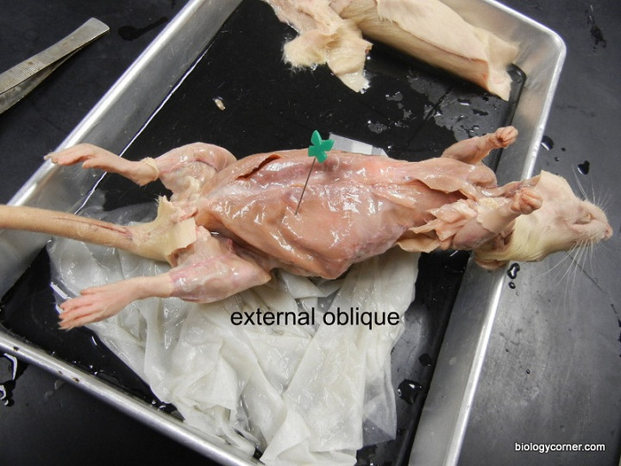
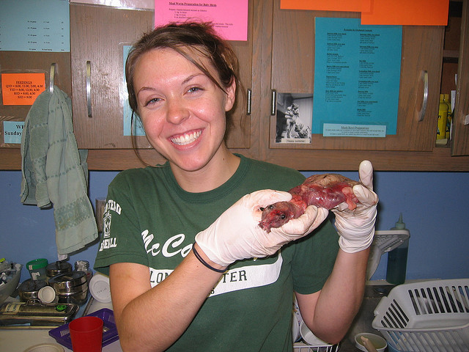
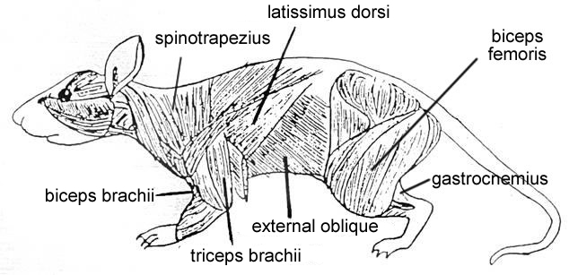
Step 1: Skinning Your Rat

Slide 3
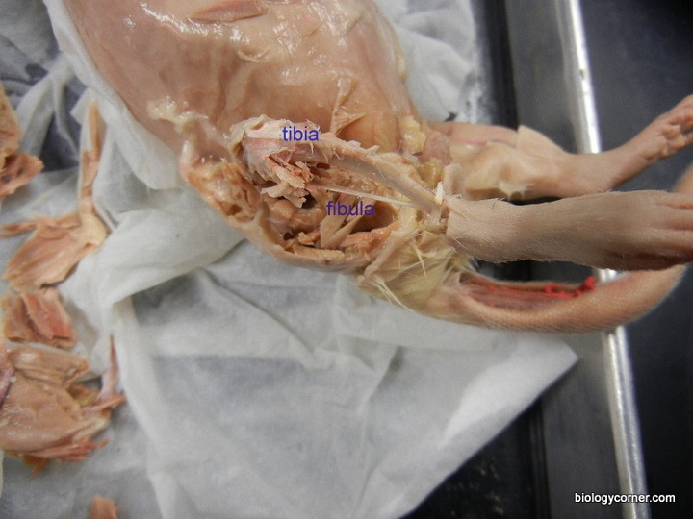
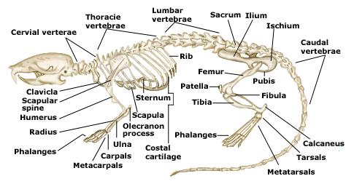
Step 2: Skeletal System

Slide 4
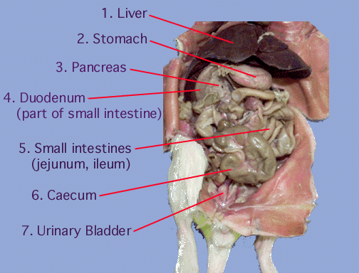
Step 3: Digestive System

Slide 5
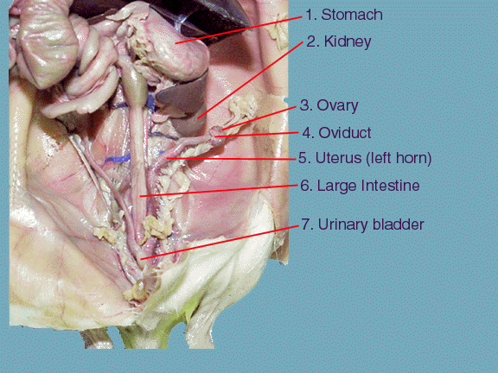
Step 4: Excretory / Reproductive System (female)

Slide 6
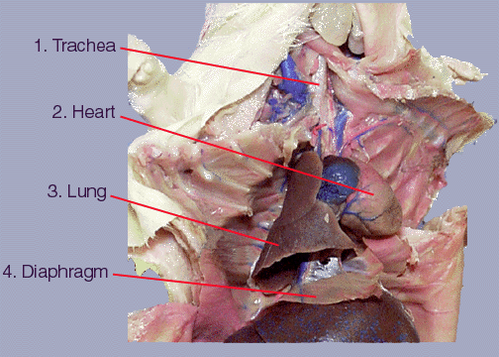
Step 5: Thoracic Cavity

Slide 7
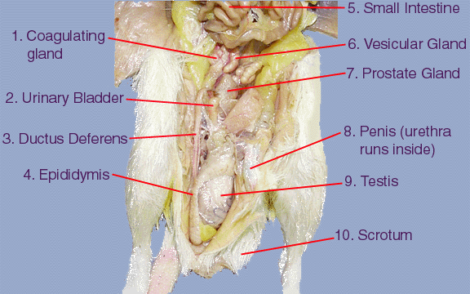
Step 4: Urinary / Reproductive System (male)

Slide 8
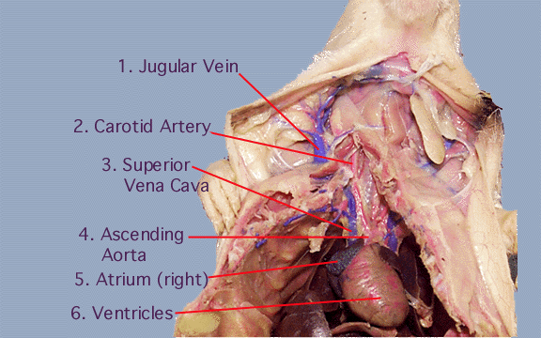

Slide 9
